Slide 1

Retention, Tenure & Promotion Process
Candidate Training Session
September 2026

Slide 2

Agenda
Provost’s Remarks, Q&A
RTP Policy Updates
Interfolio Key Concepts
Candidate Tips
How to Find Support
Next Steps
Interfolio hands-on demonstration

Slide 3
Provost’s Remarks
Encourage student participation on ROSEs
Intentionally address past RTP recommendations
Consult with Department RTP Chair
Ensure your file is complete
Utilize your resources: WPAF Checklist; Department RTP Committee; colleagues

Slide 4
Changes to RTP Policy, 2026-27
Department RTP Committees must request to meet with each candidate
Candidate may share drafts with RTP Committee before WPAF deadline
Self-assessments are single-spaced (periodic = 2 pages, full = 7 pages)
Committees complete one letter (evaluation and recommendation together); periodic = 2 pages, full = 7 pages
All candidates submit ROSEs from two courses; promotion and tenure candidates also submit a summary table
Committees may alter recommendation within 10-day candidate review period
Negative reviews at any level during periodic review will prompt additional reviews

Slide 5
What is Interfolio’s “Review, Promotion & Tenure”?
Interfolio Review, Promotion & Tenure (“RPT”) is an online system for carrying out formal faculty reviews in a shared governance context (including retention, tenure, promotion, sabbatical/leave, and any other sequential review), built to help academic institutions ensure that these processes are transparent, equitable, efficient, and well documented.
At SSU, we started using Interfolio for RTP in the 2025-26 academic year and are now using it for sabbatical/DIP applications beginning with 2026-27 academic year. Future uses include lecturer cumulative evaluations and range elevations.

Slide 6
Key Concepts
Review, Promotion & Tenure | An Interfolio module used to facilitate the RTP review process anytime a candidate submits materials that one or a series of committees needs to review or approve.
Cases | A “case” holds the WPAF and all candidate documents as they progress through a standardized review cycle. Committees and administrative reviewers will add an evaluation and recommendation to the case as it progresses through the workflow leading up to the final decision. There is a new “case” for each probationary year.
Packet | The collection of materials by which a candidate is being reviewed (documents and other files). The packet is divided into sections which can be worked on and submitted independently of one another. At SSU, this is the equivalent of the Working Personnel Action File (WPAF).
Committees | Groups of users that can review the candidates case at a given step of the review process. SSU’s committees include the Department RTP Committee, the College RTP Committee, and URTP Subcommittee.
Dossier | Tool for all faculty to store and manage job, fellowship, and promotion documents in one place. The Dossier can act as the central archiving tool for candidate materials. It is NOT accessed by the reviewing committees and is for candidates’ preparation only.

Slide 7
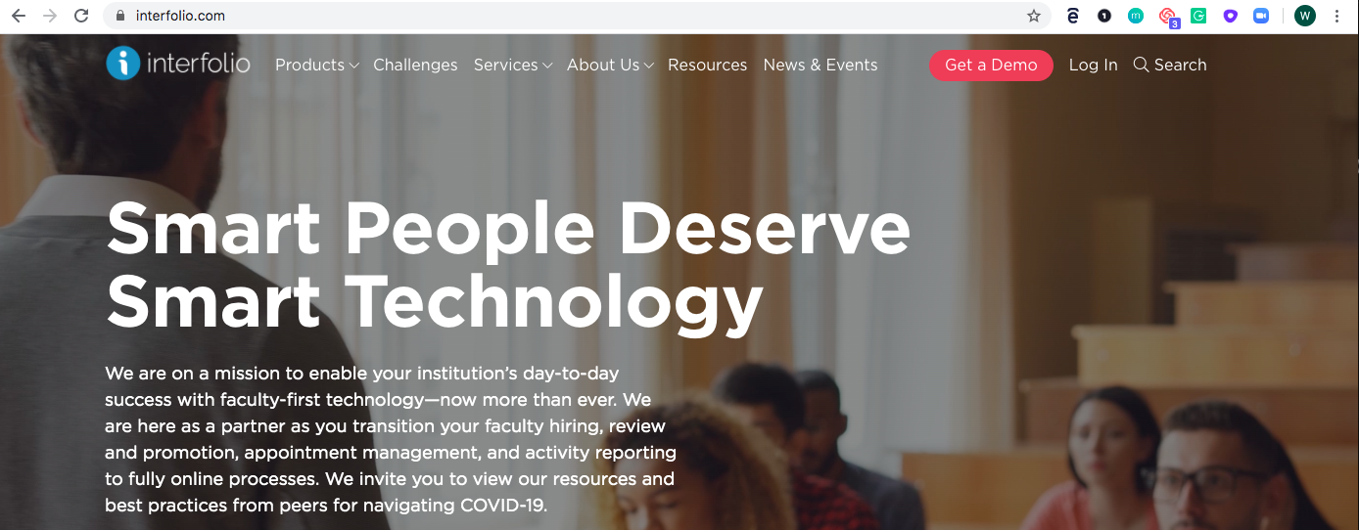
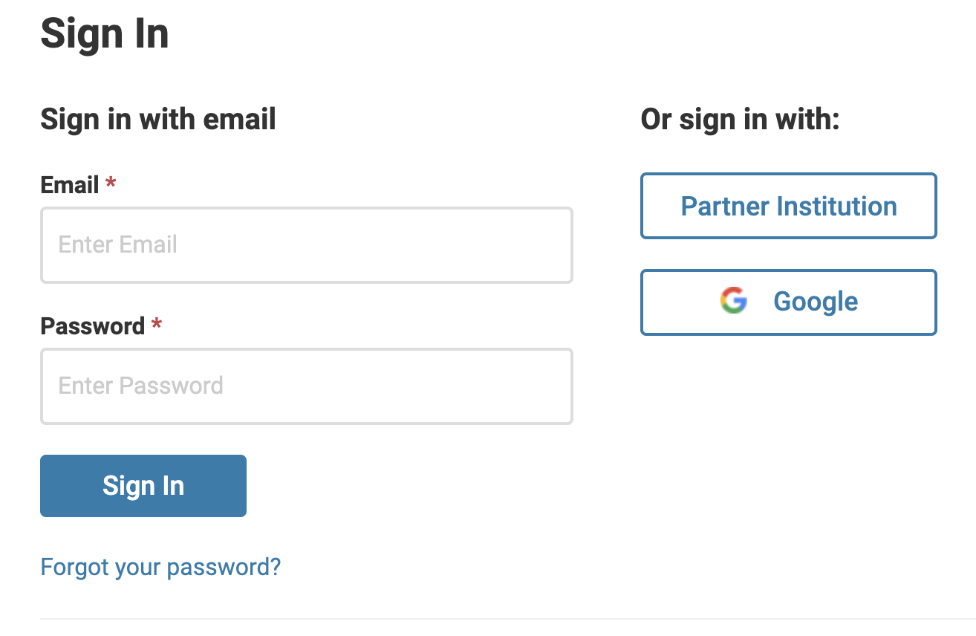
Logging into the Product

Slide 8
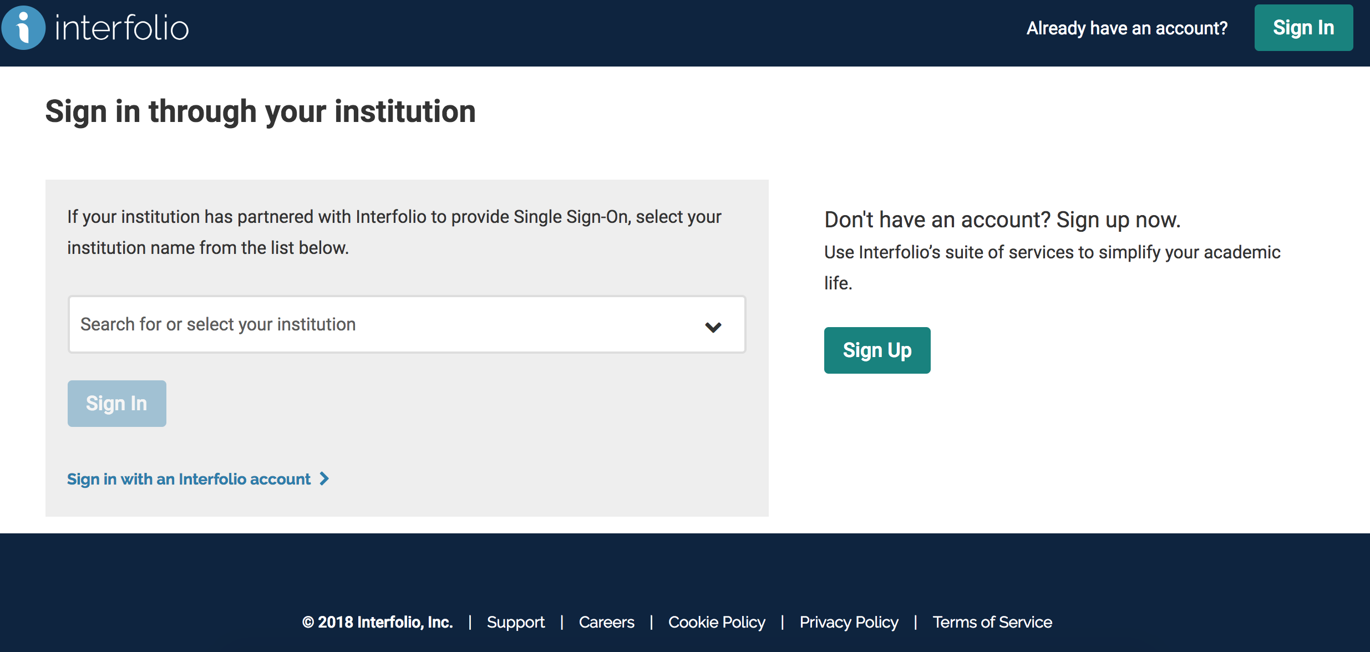
Logging into the Product

Slide 9

Candidate Tips
Interfolio Dossier
Uploading Materials
Submit all vs. individual documents for review
Rebuttal Period – no response required

Slide 10
How to Find Support: Interfolio Resources
Product Help Center
Quick help articles to guide you through specific tasks and functionality while using the product
product-help.interfolio.com
Scholar Services
Call, email, or chat with our Scholar Services team
Phone: (877) 997-8807
Email: help@interfolio.com
Faculty Affairs and Success
Nicole Hilger, Analyst
Phone: (707) 664-2184
Email: RTP@sonoma.edu

Slide 11
Interfolio: Next Steps
Candidates have received an email notifying them of the opening of their “case” (RTP file).
Candidates can begin uploading materials according to the 2026-27 RTP Calendar.

Slide 12
Questions

