Slide 1
RTP Workshop 2023
3rd and 5th Year Evaluation
Faculty Affairs and Success

Slide 2
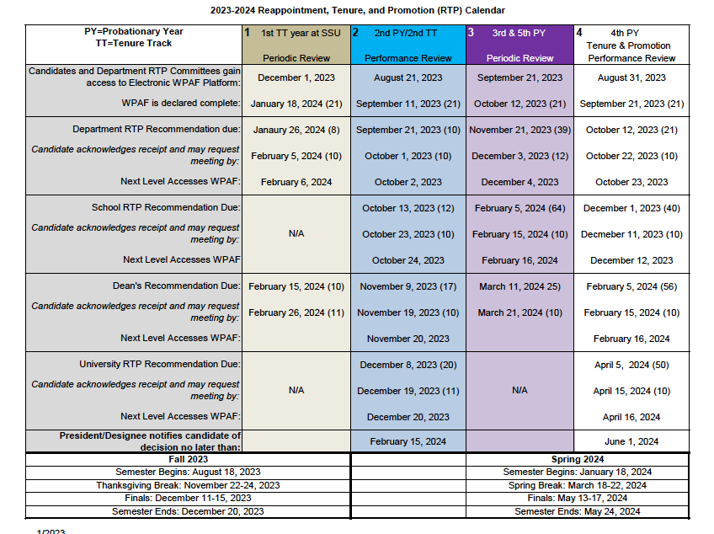

Slide 3
Criteria
Teaching
Research, Scholarship, and Creative Activities
Service
Departmental Criteria

Slide 4
Performance Evaluation (bried)
CV
Self-Assessment (no more than two pages)
One Peer Observation of Teaching from current cycle
SETEs for two courses
Index of Evidence in Google File

Slide 5
CV
Organize it into the three areas of review (Teaching, RSCA, Service)
Highlight materials submitted since last evaluation
Align it with Department Criteria as much as possible

Slide 6
Self Assessment
Strengths and areas for growth in teaching and professional activity

Slide 7
Evaluations and Recommendations
Department recommendation
School recommendation
Dean Decision
Chance to submit a rebuttal to each recommendation

Slide 8
Resources
RTP Policy
RTP Calendar
WPAF Checklist
Guide for the Evidence File (Google)
Department and School RTP Committee Members
Guides for using OnBase

